Slide 1

Improved Bug Algorithms for Robot Navigation in Unknown Environments
Oni Clement Olufayo
Wang Haiying
School of Computing, Ulster University

Slide 2

Introduction
Automation is at the core of the current technology and development. It is becoming our normal lifestyle.
Robotics is a huge aspect of automation.
Navigation is sitting at the heart of robotics.
Hence, we must stand up to the challenge of making it light, simple, effective, and efficient.

Slide 3
Existing works and approaches
Simultaneous Localization and Mapping
(SLAM)
Deep Reinforcement Learning
(DRL)
Bug Algorithms (BA)
Relatively simpler

Slide 4
Attributes of Bug Algorithms
Non-heuristic
No global knowledge
Sensor-based navigation
Simple and light
Starting point
Goal
Go-to-point
Wall-following
.

Slide 5
Objectives
The aim is to develop simple, effective, and efficient autonomous robot navigation algorithms.
To achieve this, we:
Constructively studied existing methods and approaches.
Launched innovative works from their strength; while
Exploring possible means of alleviating or eliminating shortfalls where possible.

Slide 6
Definitions and yardsticks
The simplicity of an algorithm is the degree to which the algorithm is straightforward, light (less bulky), easy to understand, and implement. It is a comparative measurement.
The effectiveness of a navigation algorithm is the probabilistic measurement of its successful navigation from any starting point to any target in any environment. This measurement is 1 (100%) if the algorithm always succeeds. For a single scenario, the effectiveness is 1, if the algorithm navigates successfully from the starting point to the goal; but 0, if the algorithm fails.
The efficiency of a navigation algorithm is the comparative measurement of how little are the resources (computation, memory, training, travel time, distance travel, energy expenditure et cetera) needed to accomplish a given navigation. In this context, it is measured with respect to the time taken, distance traveled, and energy expenditure.

Slide 7
Some bug algorithms [1]
Algorithms | Innovations | Results | Shortfalls
Bug0: The Commonsense (Com) | First, basic | Simplicity | Effectiveness challenge
Bug1: The Explorer | Memory | High effectiveness | Low efficiency, low intuition
Bug2: The M-line follower | Memory, M-line | Better intuition and efficiency | M-line bonded, no crosscut
Com1: The Commonsense plus | Memory, …next likely option | Better intuition and efficiency | No navigable-path trap
Rev2: The Left and Right follower | Memory, alternating turning | Better efficiency | Occasional failure, no navigable path trap

Slide 8
A case study
Rev2
T
F
S
Go-to-point →
Wall-following →
Trapped (repetition) - - -> (broken arrows)

Slide 9
Rev3 Advent
Rev2 could be trapped
Rescue by adding memory
The last 2 hit-points (1 not enough)
Rev3 implements a trap-escaping strategy
Contacting any of the points indicates the robot is “trapped”
Comparable short distance traveled by Rev2

Slide 10
The (Rev3) strategy
Rev3 commits the last two hit points to memory. If in contact with any, ‘follow-wall to a better take off’ at which the robot is closer to the goal than the saved points.
...Could be used to improve the effectiveness of some existing algorithms.
Coming across the last hit point in the ‘follow-wall to a better take off’ state indicates ‘no navigable path’.

Slide 11
Comparison
Rev2
Rev3
T
T
F
S
S
Go-to-point →, Wall-following →, Wall-following-to-a-better-take-off →
Trapped (repetition) - - -> (broken arrows)

Slide 12
Another instance
Rev2
Go-to-point →, Wall-following →, Wall-following-to-a-better-take-off →
Trapped (repetition) --> (broken arrows)
Rev3
T
T
F
S
S

Slide 13
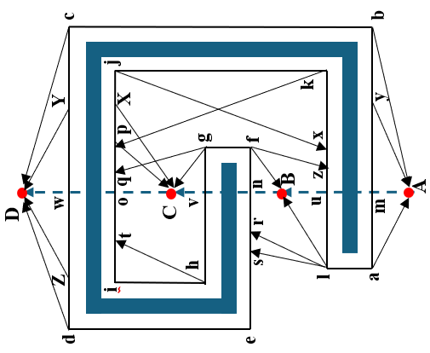
Results: efficiency measured by distance (m) traveled
Rev3 is 16.5% and 21% more efficient than Com1 and Bug2 respectively.

Slide 14
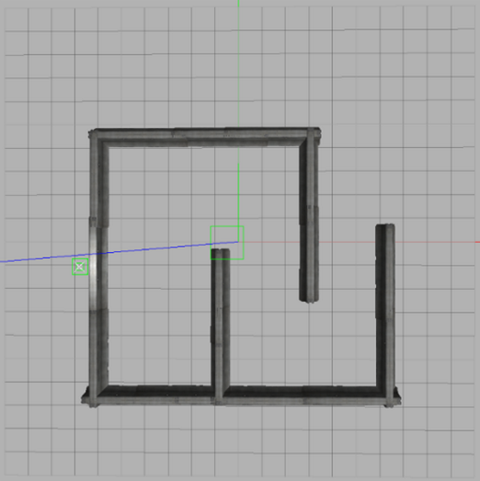
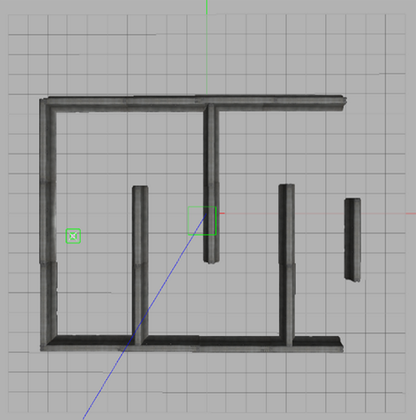
Results
Distance traveled (in meters) by bug algorithms
Map (a): A = (9, -1), B = (-4, -1), C = (-9, -1)
 | A → B | A → C | B → A | B → C | C → A | C → B | Total
Bug2 | 79.0 | 39.3 | 58.2 | 64.8 | 41.7 | 52.5 | 335.5
Com1 | 146.4 | 37.6 | 56.3 | 63.1 | 36.2 | 52.4 | 392.0
Rev2 | 70.4 | 37.5 | 23.3 | Failed | 35.3 | 44.3 | ∞
Rev3 | 70.7 | 37.1 | 23.3 | 58.5 | 35.2 | 44.9 | 269.7
Map (b): A = (9, -1), B = (-6, -1), C = (-10, -1)
 | A → B | A → C | B → A | B → C | C → A | C → B | Total
Bug2 | 102.9 | 46.9 | 74,6 | 73.5 | 61.3 | 67.0 | 426.2
Com1 | 182.9 | 41.6 | 56.4 | 72.2 | 41.6 | 66.2 | 469.9
Rev2 | 38.9 | Failed | 36.4 | Failed | 40.4 | Failed | ∞
Rev3 | 39.1 | 106.7 | 36.5 | 72.6 | 40.1 | 124.7 | 419.7
C
B
A
C
B
A
Gazebo Simulation experiments performed on Ubuntu Ros Kinetic VM on a 2.1 GHz, 32 GB RAM, 64-bit Windows 10 Operating System
Rev3 is 20% and 9.5% more efficient than Com1 and Bug2 respectively.

Slide 15
Results
Travel time (in seconds) by bug algorithms
Map (a): A = (9, -1), B = (-4, -1), C = (-9, -1)
 | A → B | A → C | B → A | B → C | C → A | C → B | Total
Bug2 | 216 | 110 | 187 | 196 | 117 | 131 | 957
Com1 | 404 | 108 | 184 | 194 | 103 | 132 | 1125
Rev2 | 184 | 112 | 83 | Failed | 94 | 117 | ∞
Rev3 | 186 | 96 | 84 | 185 | 94 | 117 | 762
Map (b): A = (9, -1), B = (-6, -1), C = (-10, -1)
 | A → B | A → C | B → A | B → C | C → A | C → B | Total
Bug2 | 323 | 128 | 251 | 222 | 192 | 189 | 1305
Com1 | 536 | 131 | 219 | 212 | 108 | 169 | 1375
Rev2 | 130 | Failed | 129 | Failed | 93 | Failed | ∞
Rev3 | 129 | 341 | 130 | 218 | 96 | 353 | 1267
C
B
A
C
B
A
Gazebo Simulation experiments performed on Ubuntu Ros Kinetic VM on a 2.1 GHz, 32 GB RAM, 64-bit Windows 10 Operating System
Rev3 is 18.8% and 10.3% more efficient than Com1 and Bug2 respectively.

Slide 16
The Multi-robot Algorithm: Com1-Rev3

Slide 17
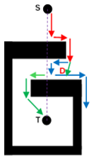
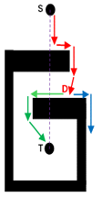
Algorithm Selection: Com1-Rev3 (why?)
Com1 and Rev2 are greedy algorithms...
Com1 and Rev3 are simple bug algorithms.
Com1-Rev3 combination reduces the possibility of robot collision... they behave alike when departing from obstacles.
Rev3 alternates its local turning direction at every new hit-point while Com1 maintains a single turning mode. At least one of them will have high efficiency in most (if not all) cases.
(a)
Bug2-Rev3 illustration
(b)
Com1-Rev3 illustration
(Neater navigation)
Both →, Bug2 in (a) →, Com1 in (b) →, Rev3 →

Slide 18
Com1-Rev3 Practical Simulation and Design
The design:
is a combination of algorithms
is a rospy package:
scripts, urdf, world, launch folders
is a service selection system:
go-to-point
wall-following
hold-on
Consists of a coordinating script

Slide 19
Interactions between the robots
The coordinating script manages all interactions; mainly for collision avoidance and energy conservation.

Slide 20
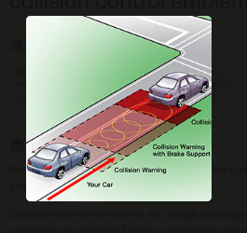
Collision control:
provided by ‘hold-on’ service
Ordinarily, colleague = obstacle
Necessary for Rev algorithm
Condition of operation for the dual-robot navigation:
Enough space

Slide 21
Energy conservation
T
R3
C2
C3
R2
C1
R1
As soon as sure of the robot that will get to the goal first, the partner stops to save energy. 3 conditions must be met to be sure a robot will reach the goal first:
It must be in the ‘go-to-point’ state (free-heading toward the goal).
There must be no obstacle between the robot and the goal.
It must be closer to the goal than its counterpart.

Slide 22
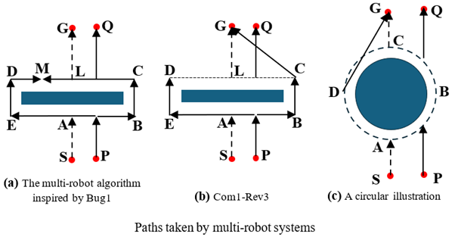
Com1-Rev3 versus multi-robot system inspired by Bug1 [2]
For a two-robot system inspired by Bug1 as illustrated in Fig (a):
The two robots travel in opposite directions along the obstacle border while keeping track of the point with the minimum distance to the goal.
When the two robots meet, they compare their saved shortest distance to the goal to know the actual point, on the border, closest to the goal (say point L).
They then return to L to take off and move straight to the goal.

Slide 23
Com1-Rev3 versus multi-robot system inspired by Bug1
For a simple rectangular obstacle, the total distance traveled by the two robots in Com1-Rev3 will always be less than that of the multi-robot algorithm inspired by Bug1 by at least half the length of the obstacle. Hence Com1-Rev3 has a better energy expenditure.
For a circular obstacle, the total distance traveled by the multi-robot algorithm inspired by Bug1 is at least one-quarter of the obstacle circumference greater than the total distance traveled by Com1-Rev3.

Slide 24
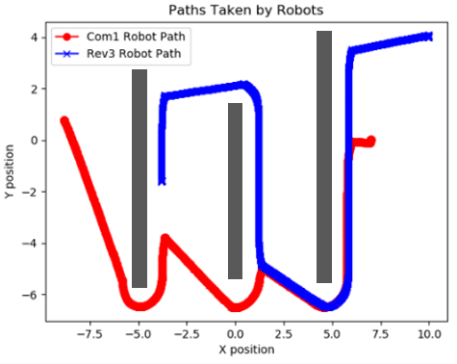
Com1-Rev3 navigation samples
Start: Com1 (7, 0), Rev3 (9, 4). Rev3 stopped at (3.8, -1.5). Com1 reached the target (-9, 1)

Slide 25
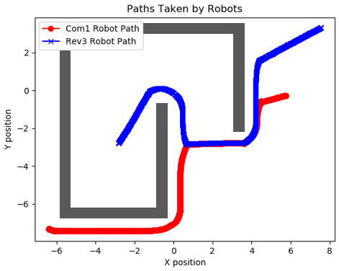
Com1-Rev3 navigation samples
Start: Com1 (6, 0), Rev3 (9, 4). Rev3 stopped at (-6.4, -7.3). Rev3 reached the target: (-3, -3)

Slide 26
Summary
Two improved bug algorithms were developed:
Rev3 is an innovation of Rev2 that demonstrates higher efficiency than the five other algorithms compared with it. It moves the robot towards the goal and alternates turning direction at every hit point while keeping the record of the last two hit points. If the robot comes across any saved point, it follows the obstacle boundary until it is closer to the goal than the saved points.
Com1-Rev3 is a simple but efficient dual-bug algorithm made of two different single-bug algorithms (Com1 and Rev3). For collision avoidance, the Rev3 robot is configured to stop moving whenever it is close to the Com1 robot. As they travel, if any is sure of reaching the goal first, the other robot stops moving to save energy.

Slide 27
Merits
The developed algorithms drastically curtail failure.
The consistent efficiency of the dual-robot algorithm is desirable. It performs outstandingly in most situations.
Collision issue, a multi-robot challenge, is resolved provided the robot has enough space for traveling.
Waiting time is drastically reduced and occurs only when a collision is to be avoided.
Failure possibility is a major factor in the poor performance of Bug0 and Rev2. They could be improved upon by introducing additional features as done to Rev2 in this study.

Slide 28
Limitations and future works
Navigation space management.
Hold-on service is called whenever the two robots are close. The ability to discriminate between collision and closeness is a needed attribute.
Extension to swarm robot implementation and the best proportional combination and variation.
The implementation of Com1-Rev3 on live robots should be embarked on to finetune the algorithm for real-life applications.

Slide 29
References
[1] K.N. McGuire, G.C.H.E. de Croon, K. Tuyls, “A comparative study of bug algorithms for robot navigation” 2019 Robotics and Autonomous Systems, Volume 121, 2019, 103261, ISSN 0921- 8890, https://www.sciencedirect.com/science/article/pii/ S0921889018306687, [Accessed 10 01 2024].
[2] J. J. Kandathil, R. Mathew, S. S. Hiremath. Development and analysis of a novel obstacle avoidance strategy for a multi-robot system inspired by the Bug-1 algorithm. SIMULATION. 2020;96(10):807-824. doi:10.1177/0037549720930082

Slide 30
Thank you!
Thank you!
Thank you!
Thank you!
Thank you!
Thank you!
Thank you!
Thank you!
Thank you!
Thank you!
Thank you!
Thank you!
Q u e s t i o n s?

